Slide 1
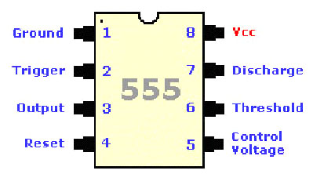
555 Timer
The 555 Timer is one of the most popular
and versatile integrated circuits ever produced!
It is 30 years old and still being used!
It is a combination of digital and analog circuits.
It is known as the “time machine” as it performs a wide variety of timing tasks.
Applications for the 555 Timer include:
  Bounce-free switches and Cascaded timers
  Frequency dividers
  Voltage-controlled oscillators
  Pulse generators and LED flashers

Slide 2
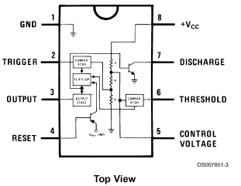
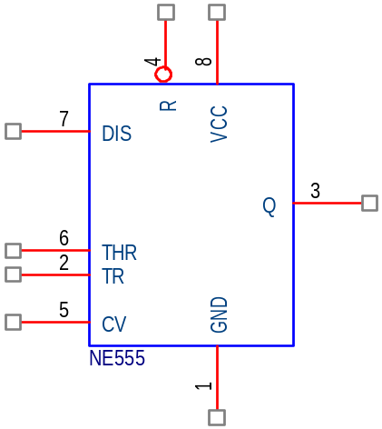
555 Timer
Each pin has a function, the meaning of which will become clearer later.
Note some familiar components inside

Slide 3
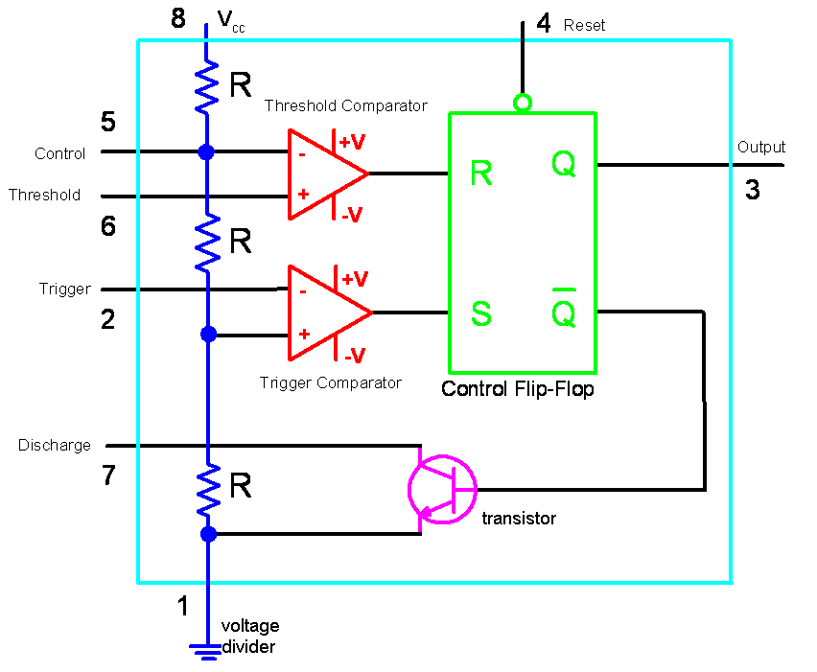
Inside the 555 Timer

Slide 4
Inside the 555 Timer
You will learn more about these components later in the course, for now just understand the following:
  The voltage divider has three equal 5K resistors. It divides the input voltage (Vcc) into three equal parts.
  The two comparators are op-amps which compare the voltages at their inputs and saturate depending upon which is greater.
  The flip-flop is a bi-stable device. It generates two values, a “high” value equal to Vcc and a “low” value equal to 0V.
  The transistor is being used as a switch, it connects pin 7 (discharge) to ground when it is closed.

Slide 5
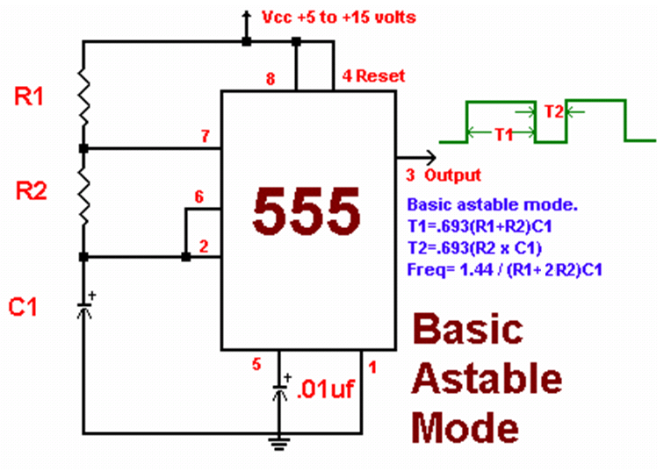
Periodic Pulse Train from a 555 Timer
555-Timers, like op-amps can be configured in different ways to create different circuits. We will now look into how this one creates a train of equal pulses, as shown at the output.

Slide 6
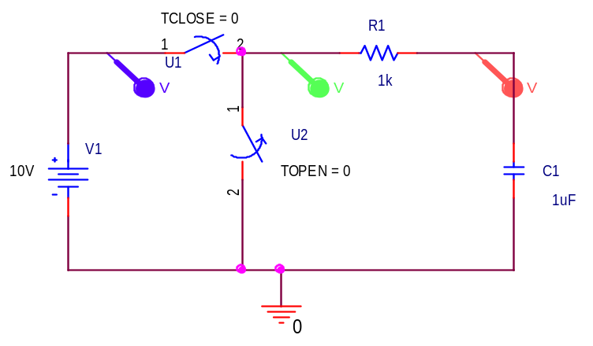
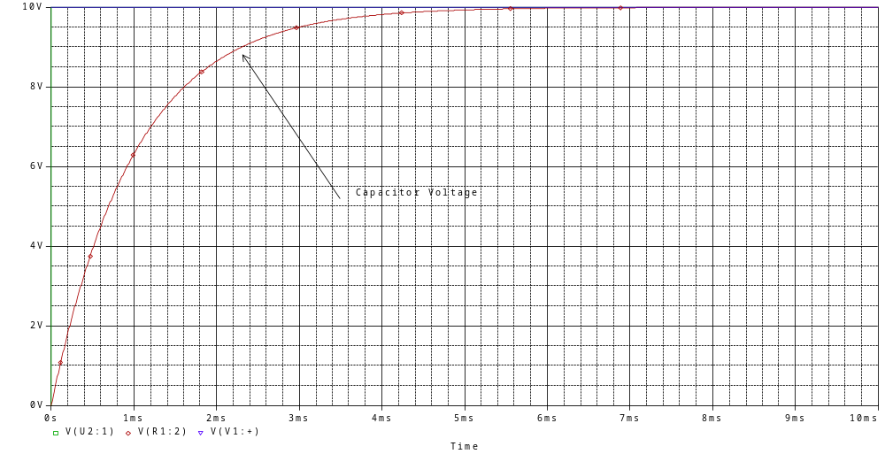
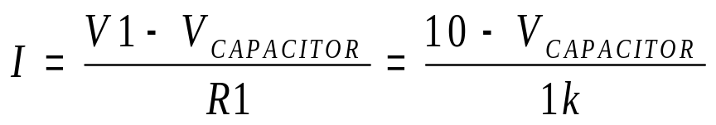
First we must examine how capacitors charge
Capacitor C1 is charged up by current flowing through R1
As the capacitor charges up, its voltage increases and the current charging it decreases, resulting in the charging rate shown

Slide 7
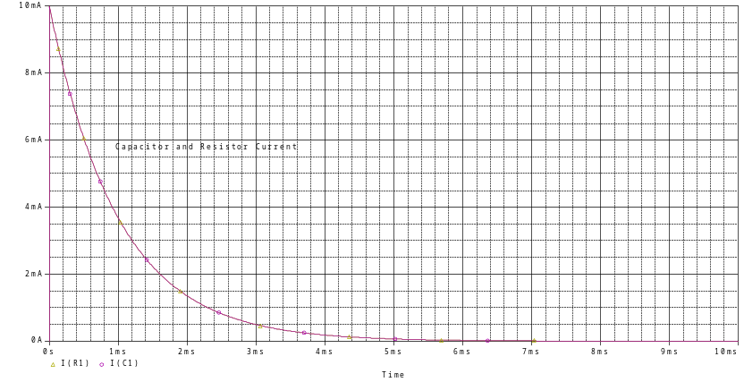
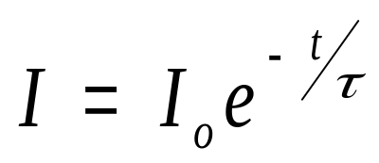
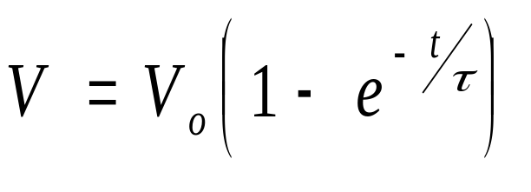

Capacitor Charging Equations
Capacitor Current
Capacitor Voltage
Where the time constant

Slide 8
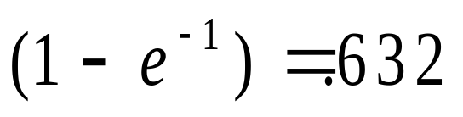
Understanding the equations
Note that the voltage rises to a little above 6V in 1ms.

Slide 9
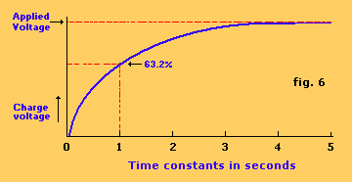
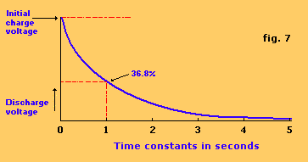
Capacitor Charging and Discharging
There is a good description of capacitor charging and its use in 555 timer circuits at http://www.uoguelph.ca/~antoon/gadgets/555/555.html

Slide 10
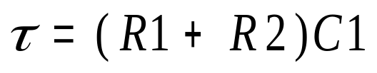
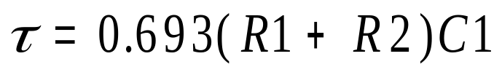
555 Timer
At the beginning of the cycle, C1 is charged through resistors R1 and R2. The charging time constant is
The voltage reaches (2/3)Vcc in a time

Slide 11
555 Timer
When the voltage on the capacitor reaches (2/3)Vcc, a switch (the transistor) is closed at pin 7 and the capacitor is discharged to (1/3)Vcc, at which time the switch is opened and the cycle starts over

Slide 12
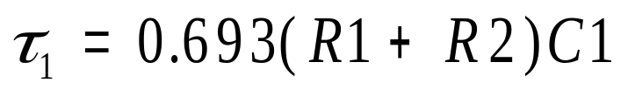
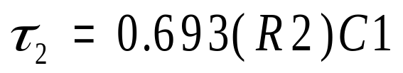
555 Timer
The capacitor voltage cycles back and forth between (2/3)Vcc and (1/3)Vcc at times and

Slide 13
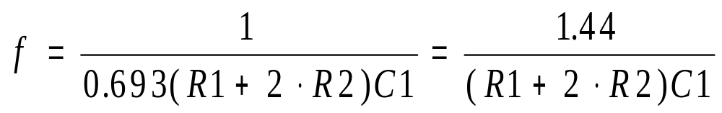
555 Timer
The frequency is then given by

Slide 14
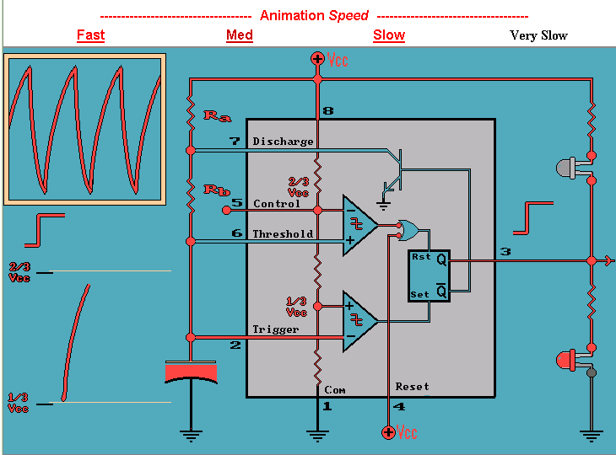
555 Animation
Output is high for 0.693(R_{a}+R_{b})C
Output voltage high turns off upper LED and turns on lower LED
Capacitor is charging through R_{a} and R_{b}
http://www.williamson-labs.com/pu-aa-555-timer_slow.htm

Slide 15
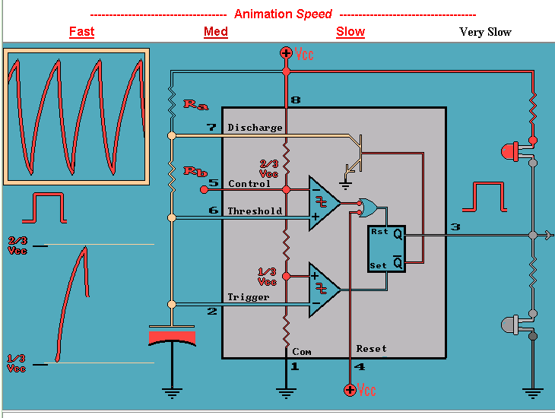
555 Animation
Output is low for 0.693(R_{b})C
Output is low so the upper LED is on and the lower LED is off
Capacitor is discharging through R_{b}

Slide 16
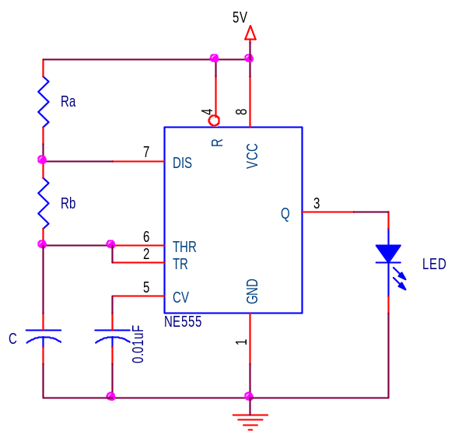
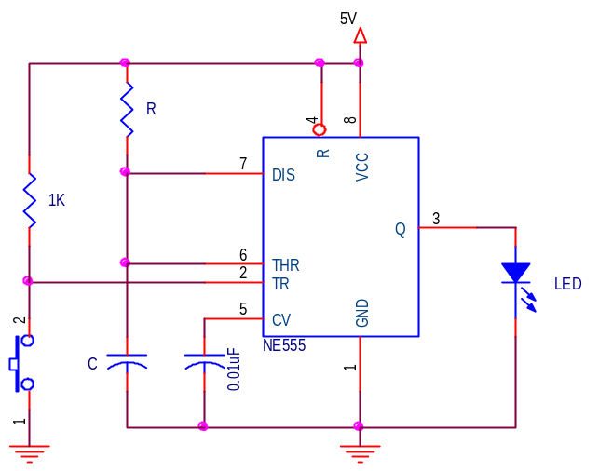
Types of 555-Timer Circuits
Astable Multivibrator puts out a continuous sequence of pulses
Monostable Multivibrator (or one-shot) puts out one pulse each time the switch is connected

Slide 17
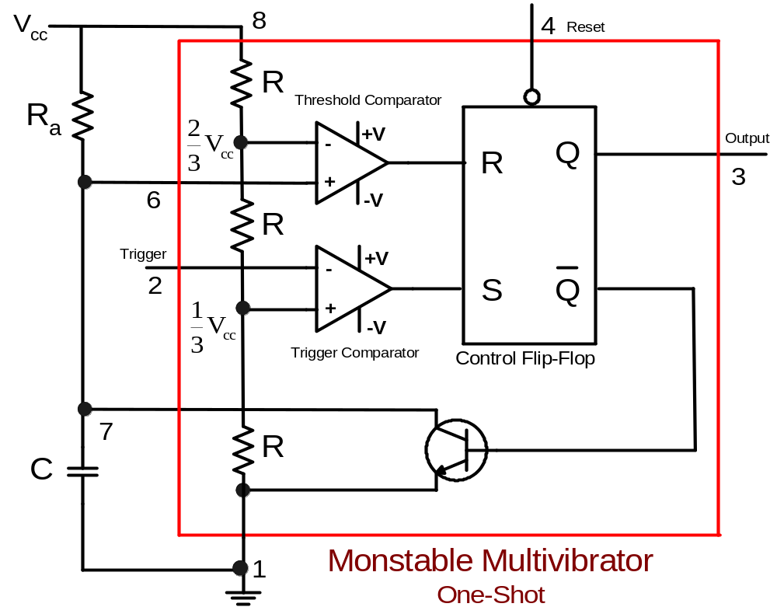
Monostable Multivibrator (One Shot)

Slide 18
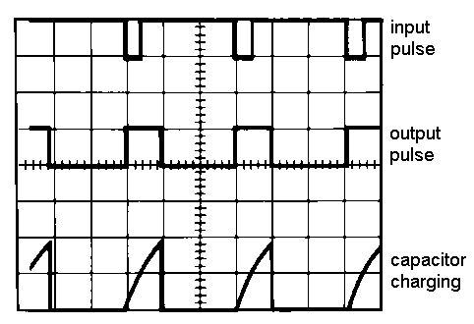
Behavior of the Monostable Multivibrator
The monostable multivibrator is constructed by adding an external capacitor and resistor to a 555 timer.
The circuit generates a single pulse of desired duration when it receives a trigger signal, hence it is also called a one-shot.
The time constant of the
resistor-capacitor
combination determines
the length of the pulse.

Slide 19
Uses of the Monostable Multivibrator
  Used to generate a clean pulse of the correct height and duration for a digital system
  Used to turn circuits or external components on or off for a specific length of time.
  Used to generate delays.
  Can be cascaded to create a variety of sequential timing pulses. These pulses can allow you to time and sequence a number of related operations.

Slide 20
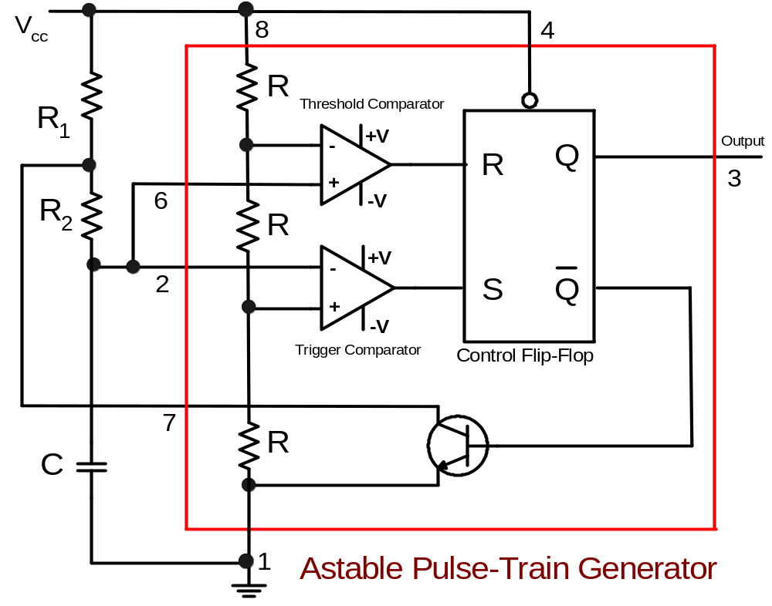
Astable Pulse-Train Generator (Multivibrator)

Slide 21
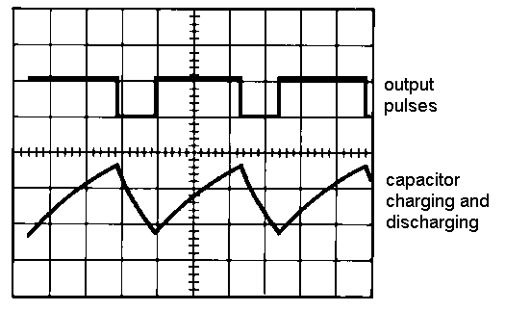
Behavior of the Astable Multivibrator
The astable multivibrator is simply an oscillator. The astable multivibrator generates a continuous stream of rectangular off-on pulses that switch between two voltage levels.
The frequency of the pulses and their duty cycle are dependent upon the RC network values.
The capacitor C charges through the series resistors R₁ and R₂ with a time constant
(R₁ + R₂)C.
The capacitor discharges
through R₂ with a time
constant of R₂C

Slide 22
Uses of the Astable Multivibrator
  Flashing LED’s
  Pulse Width Modulation
  Pulse Position Modulation
  Periodic Timers (see mushroom timer in the experiment).

Slide 23
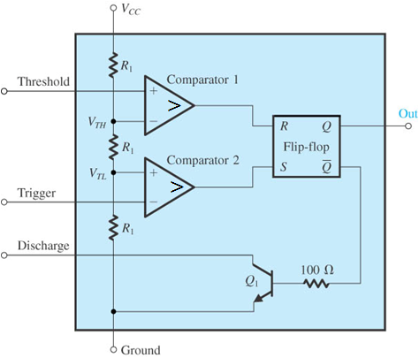
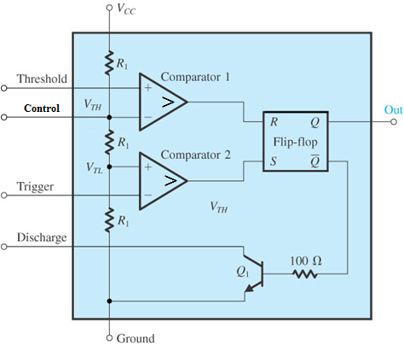
555 Timer
Figure 13.27 A block diagram representation of the internal circuit of the 555 integrated-circuit timer.
Notes:
sedr42021_1327.jpg

Slide 24
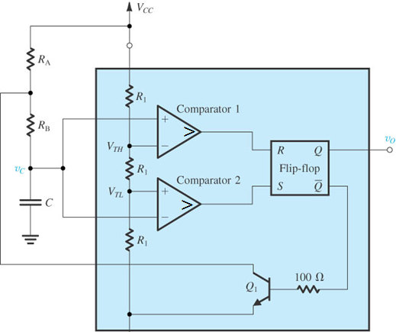
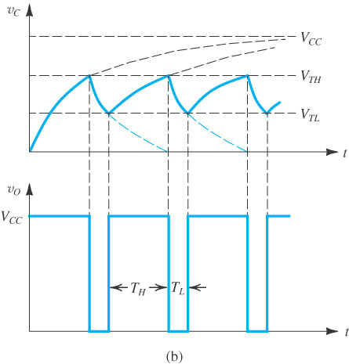
Astable
Figure 13.29 (a) The 555 timer connected to implement an astable multivibrator. (b) Waveforms of the circuit in (a).
Notes:
sedr42021_1329a.jpg

Slide 25
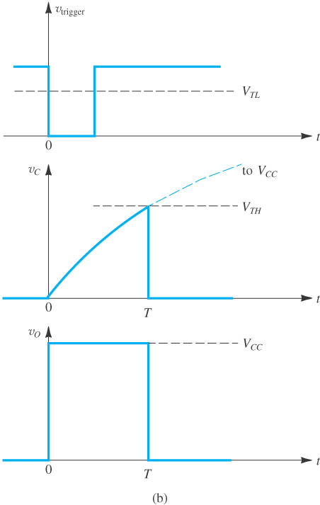
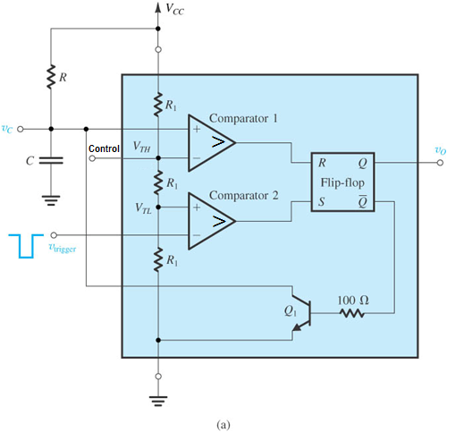
Monostable
V_{control} , varies width
Figure 13.28 (a) The 555 timer connected to implement a monostable multivibrator. (b) Waveforms of the circuit in (a).
Notes:
sedr42021_1328a.jpg

